Slide 1
RESUMES and CVs
Access Today’s Materials
www.writingcenter.ua.edu/workshops

Slide 2
Required Sections (for both)
HEADER/CONTACT INFORMATION
EDUCATION
PROFESSIONAL EXPERIENCE/WORK EXPERIENCE

Slide 3
Optional Sections
Honors/Awards
Leadership Opportunities
Research Experience
Activities
Volunteer Experience/Community Service
These can vary! There are lots of creative ways to organize information on your resume or CV.

Slide 4
RESUMES vs. CVs
Whereas a resume focuses on work experience, a CV expands on research and academic accomplishments.
A resume is one page, while a CV can be longer and more detailed.
There are lots of examples online, including at UA Career Center, but this page from UC Davis has good examples.
Reverse chronological order is most common (but not the only) format

Slide 5
CV Content
A CV contains everything on your resume, plus:
Research/lab experience
Teaching Experience
Thesis and Dissertation Information (title, advisor or committee names)
Professional Development (i.e.., summer research programs)
Major Academic Projects (service learning, field experience)
Publications
Conference Presentations or poster sessions (national, regional, local)
Evidence of DEI experience or involvement
Grants/External Funding

Slide 6
Typical Resume Entry for Work Experience
Research Program Fellow, August-December, 2022 Department of Biological Sciences, Columbia University, New York City
Assisted on research in probiotics and cancer cells.
Delivered presentations on work-in-progress to departmental working group.
Mentored middle-school students interested in STEM.

Slide 7
Typical CV Entry for Work Experience
Research Program Fellow, August – December 2022 Department of Biological Sciences, Columbia University, New York City Advisors: John Smith and Mary Johns
Designed and engineered probiotics to specifically invade cancer cells and release shRNAs into the cytoplasm to knockdown oncogenes, resulting in cancer cells dying or turning into normal cells, depending on target gene. Developed project goals and methods, built and tested the genetic circuits with cloning and cell culture work. Led introductory workshops and lab tour in synthetic biology to elementary, middle, and high school students, in partnership with HYPOTHEkids and ThinkSTEAM.

Slide 8
Formatting Considerations
CVs are more standard than resumes but will still vary by field. Ask someone in your field to review your CV.
CV format can be more traditional than resume, but doesn’t have to be dull. Don’t go overboard, but do make it visually appealing
Don’t use the space or tab bar to create columns***
Instead, create columns or a table with invisible borders. It will keep your items neatly divided, and you can insert or delete as needed.

Slide 9
Best Practices for CVs & Resumes
Spell out acronyms and make sure that all items are clear to an outside reader (job titles, organizations that you worked for, etc.). Add explanation where needed.
Use action verbs to describe work experiences.
Don’t use “responsible for” or “duties included…”
Describe past experience in past tense, current items in present.
Spellcheck.
Have other people read and review your resume before you send it out.

Slide 10
Examples of Action Verb Phrases from UA Career Center
Weak: Assisted with promotions
Strong: Managed social media accounts, generating an increase in website traffic
Weak: Duties included customer service
Strong: Provided excellent customer service during each shift, garnering positive feedback from clients and manager
Weak: Serve as treasurer
Strong: Oversee budget of $30,000, tracking all spending and monitoring adherence to policies

Slide 11
How to Get Started
If you’re getting started, use our brainstorming worksheet to create a list of your achievements.
If you’re transforming a resume into a CV, use the resume as a starting point to expand.

Slide 12
If you have a draft…
Ask several people to read it, including, if possible, a professor or someone in your desired field.
Consider using AI tools to improve your action verb phrases.
Check for consistency (format, grammar, visual, etc.)

Slide 13
And…. Bring your CV to the UA Writing Center!
The UA Writing Center is a free, collaborative, consultation service available to all members of the UA community.
You can bring papers at any stage of the writing process.
Peer consultants can help with any kind of writing– personal, professional, or course-related.
We work with writers at all levels, from novice students to dissertation writers and published researchers.

Slide 14
Appointment Options
In-Person
Lloyd Hall, M-F Appointments (recommended) or drop-in
Online
All by appointment, Sun-Fri
Choose between Zoom or Asynchronous.

Slide 15
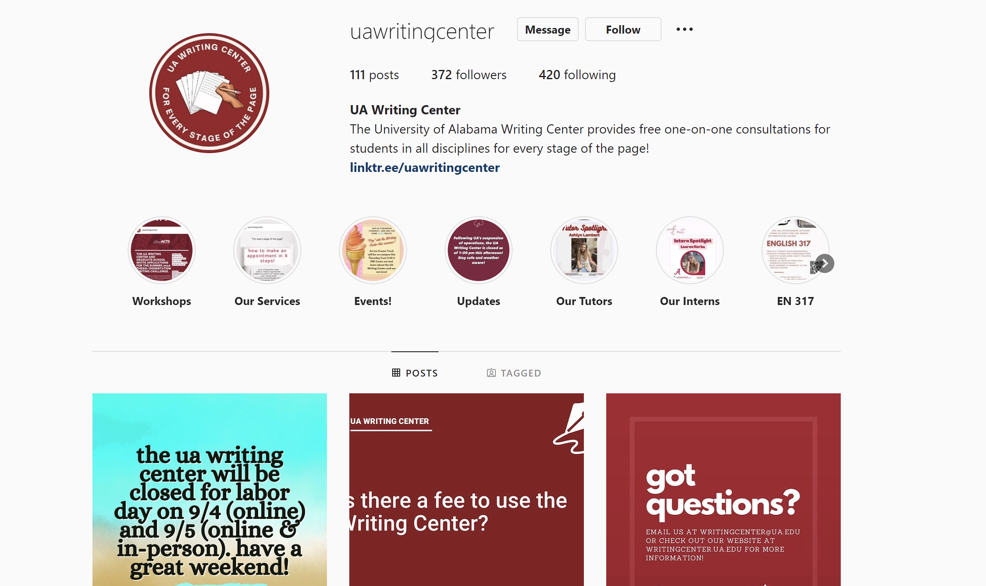
Connect with us!
Get started at: writingcenter.ua.edu
Check out our online resources, create an account, and make an appointment
Follow us on Facebook, Twitter, and Instagram for updates on Writing Center events!
E-mail us: writingcenter@ua.edu

